Slide 1
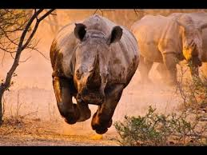
Agile Estimating While Being Chased by a Rhino
You’re being chased by a rhino
You come upon a tree with limbs side by side with a huge boulder with hand and footholds
Which do you climb for best chances of a Minimum Survivable Solution (MSS)
Quick! You have a couple of seconds to choose!
<number>

Slide 2
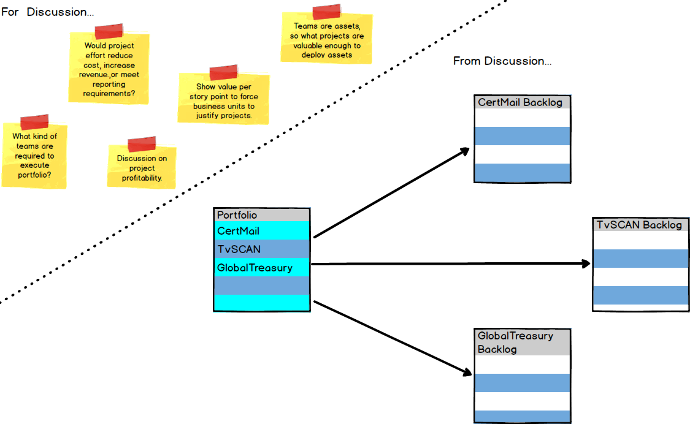
One Portfolio Backlog, Many Product Backlogs
<number>

Slide 3
What goes into Portfolio Backlog?
Market Value | Will this project allow us to: Sell more product? Reduce our cost to provide our services?
Risk Reduction | How will completing this project allow us to: Develop or refine what we know about our business? Prove technical assumptions?
Capability Building | Will completing this project: Enable us to do something we couldn't do before, or do it better? Reduce or eliminate the need for low-value activity?
<number>

Slide 4
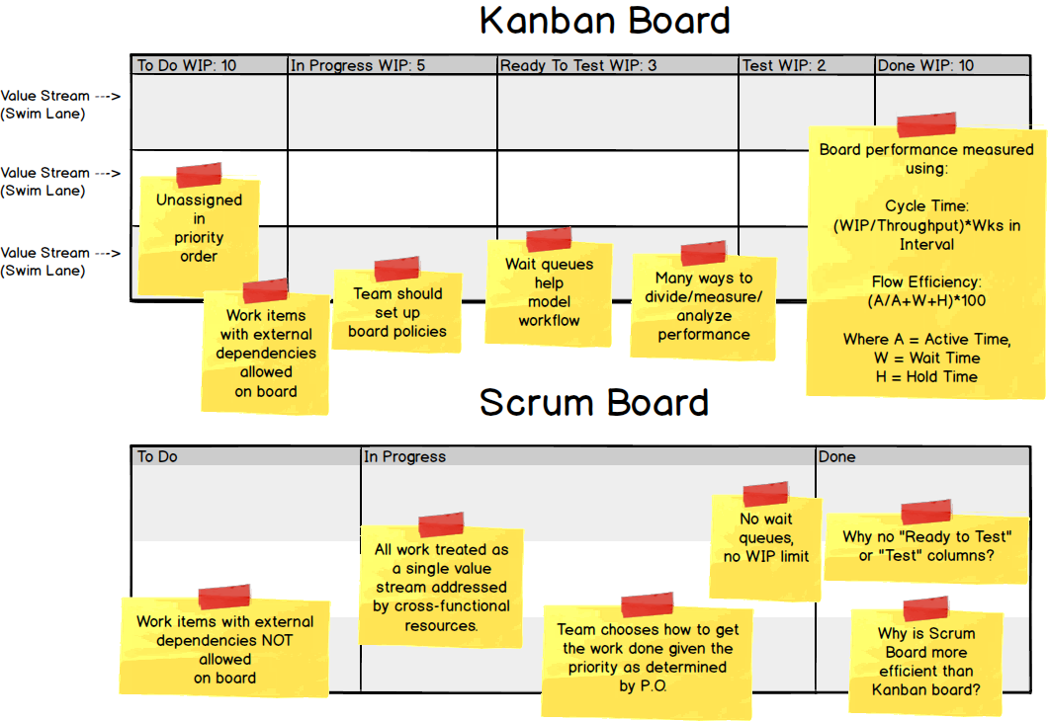
Comparison of Scrum and Kanban Processes
<number>

Slide 5
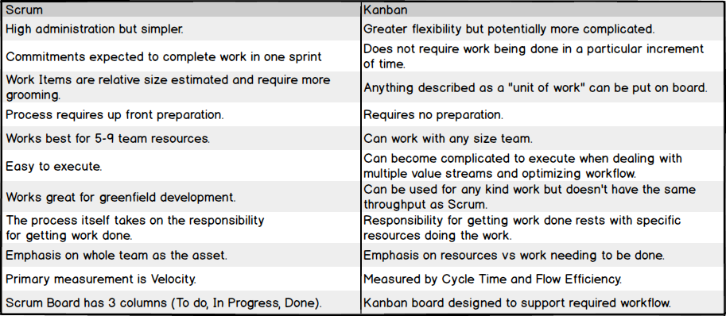
Comparison of Scrum and Kanban Processes
<number>

